Slide 1
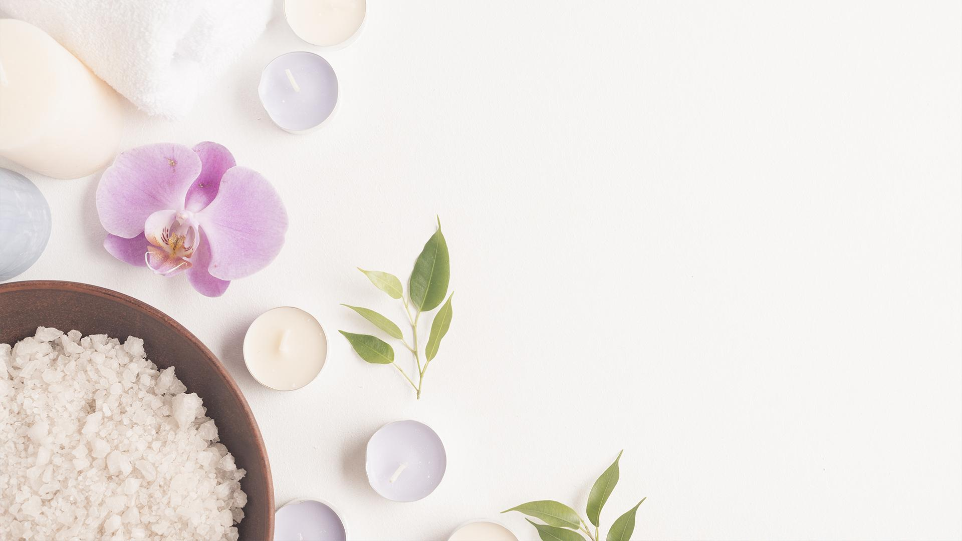
Relaxation et bien-être au travail

Slide 2
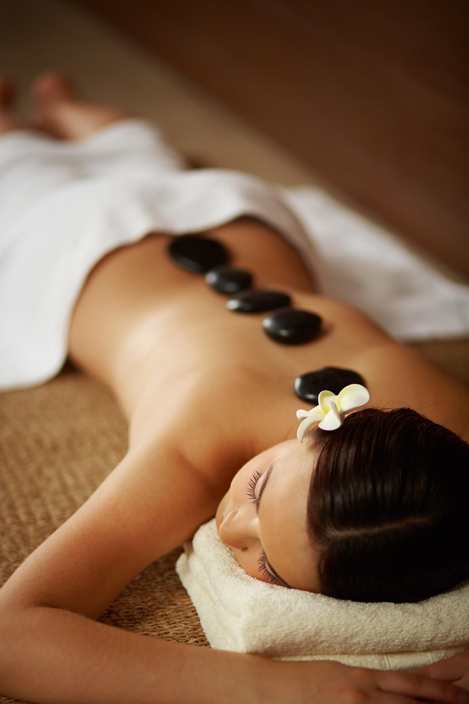
Whoa!
It could be the part of the presentation where you can introduce yourself, write
your email…

Slide 3

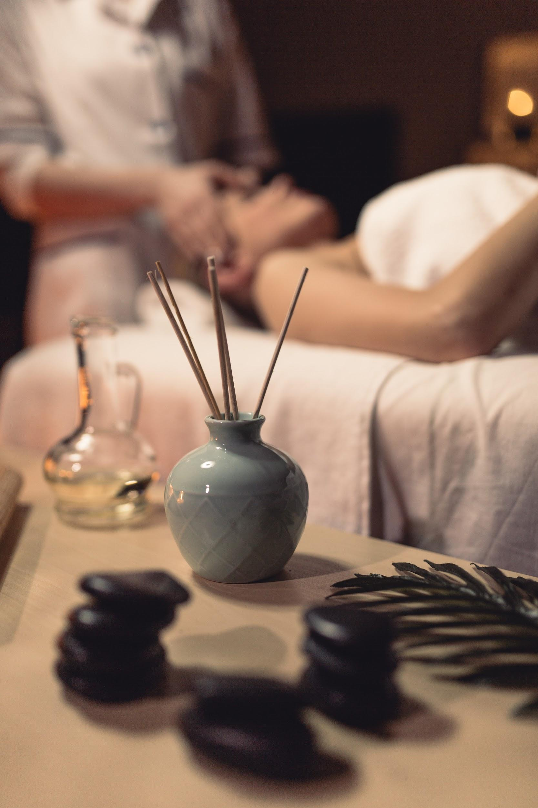
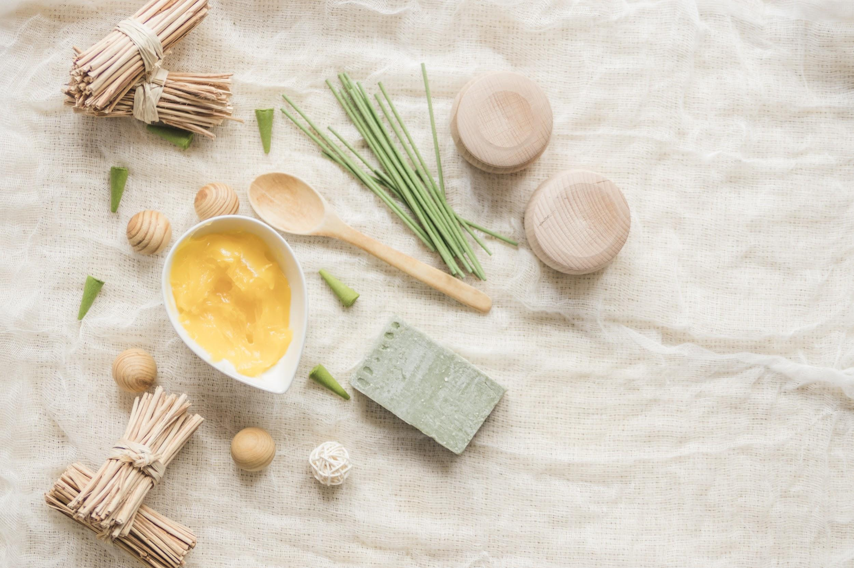
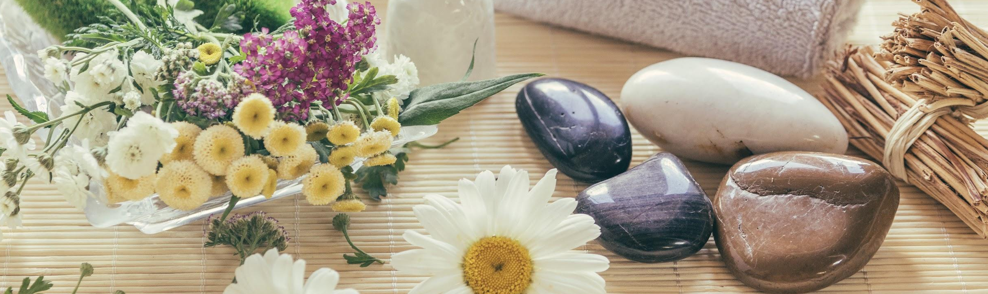
Sometimes, reviewing concepts is a good idea
JUPITER
It’s a gas giant and the biggest planet in our Solar System. It’s also the fourth-brightest object in the sky
VENUS
Venus has a beautiful name, but it’s terribly hot, even hotter than Mercury
MERCURY
Mercury is the closest planet to the Sun and is only a bit larger than our Moon
MARS
Despite being red, Mars is a cold place, not hot. The planet is full of iron oxide dust

Slide 4
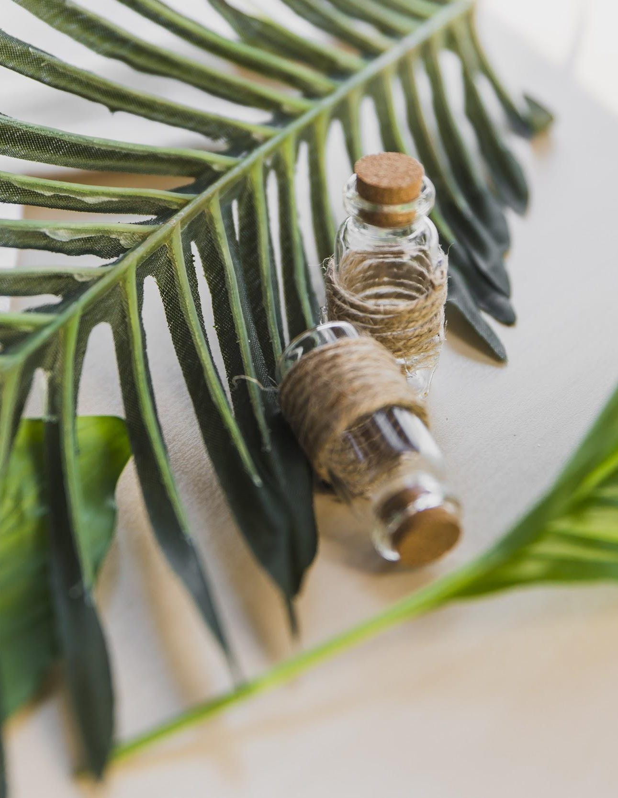
A picture always
reinforces the concept
Images reveal large amounts of
data, so remember: use an
image instead of long texts. Your
audience will appreciate that

Slide 5

A picture always
reinforces the concept
Images reveal large amounts of
data quickly, so remember: use an
image instead of long texts. Your
audience will appreciate that

Slide 6
Infographics make your idea understandable
Mercury is the closest planet to the Sun and is only a bit larger than our Moon
Venus has a beautiful name, but it’s terribly hot, even hotter than Mercury
Despite being red, Mars is a cold place, not hot. The planet is full of iron oxide dust
Jupiter is a gas giant and the biggest planet in our Solar System

Slide 7
… and the same goes for tables
 | MASS (earths) | DIAMETER (earths) | SURFACE GRAVITY (earths)
MERCURY | 321 | 365 | 12
MARS | 251 | 789 | 651
SATURN | 125 | 256 | 955

Slide 8
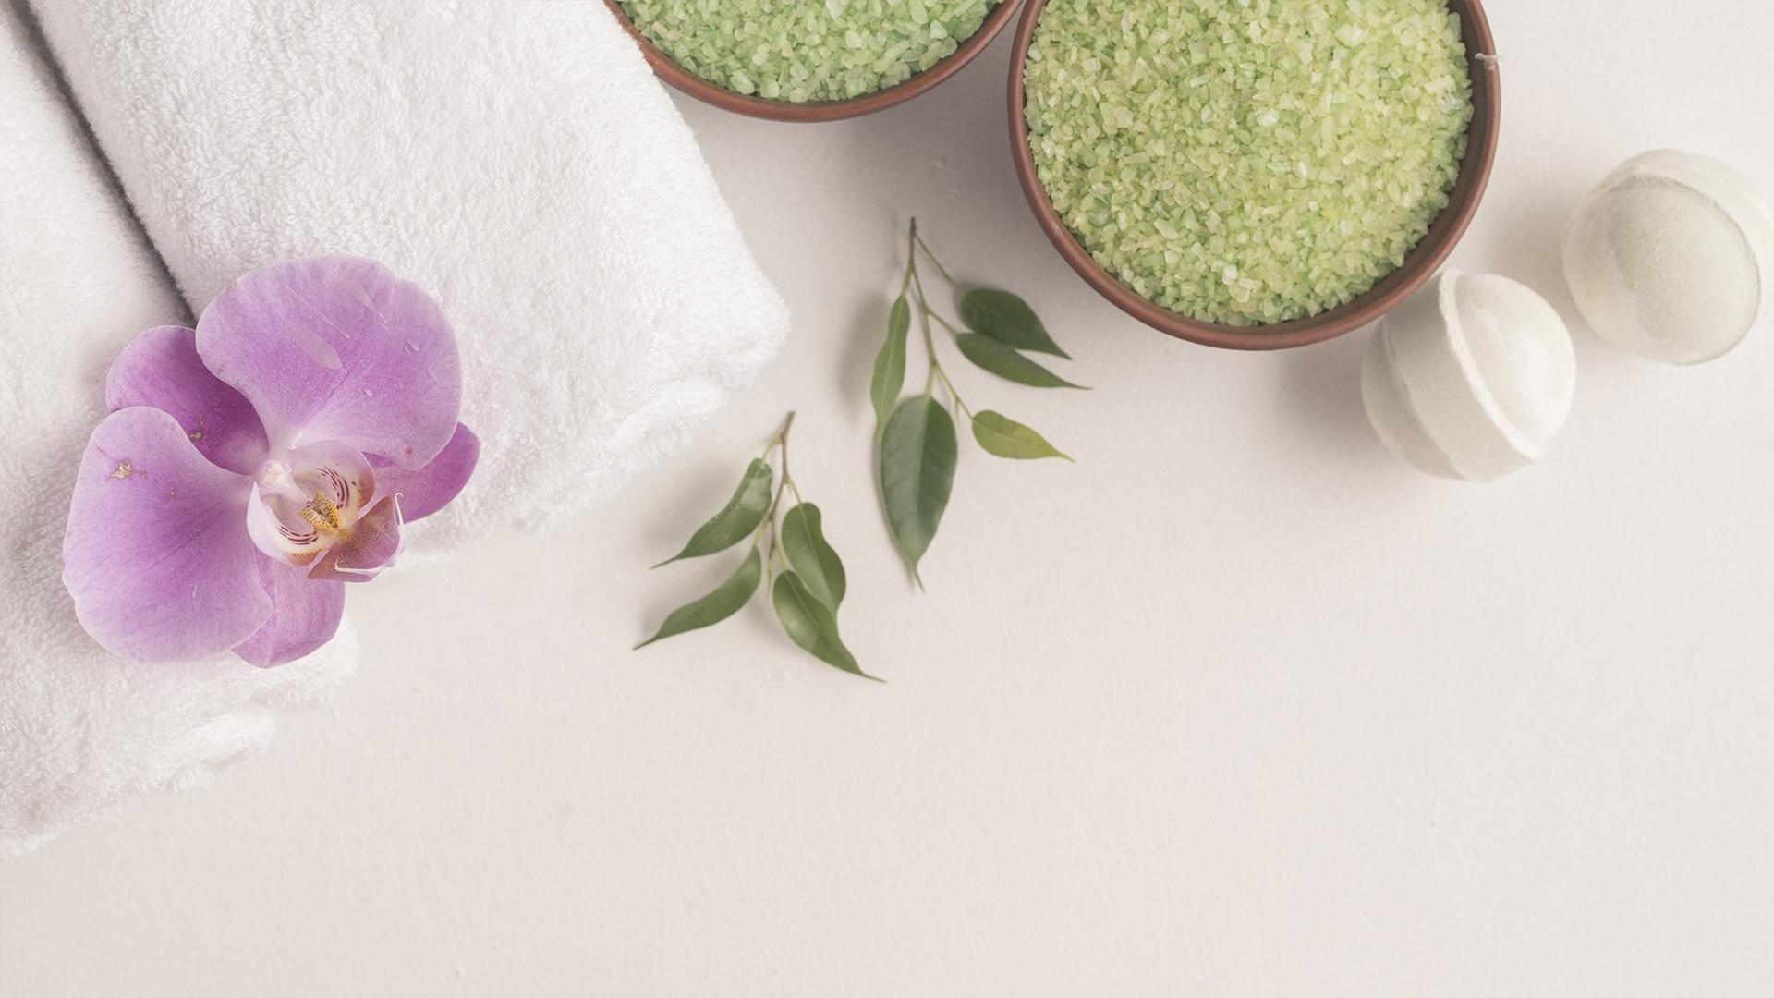
Awesome words
Day 1
Mercury is the closest planet to the Sun
Day 2
Venus has a beautiful name, but it’s terribly hot
Day 3
Despite being red, Mars is a cold place.
Day 4
Jupiter is the biggest planet in our Solar System

Slide 9
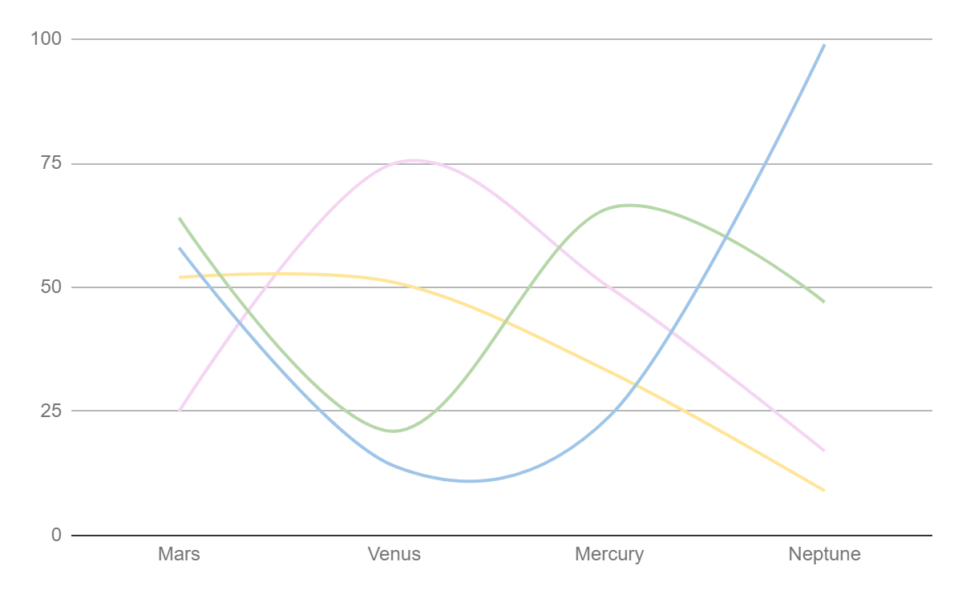
If you want to modify this graph, click on it, follow the link, change the data and replace it
JUPITER
It’s a gas giant and the biggest planet in our Solar System. It’s also the fourth-brightest object in the sky
VENUS
Venus has a beautiful name, but it’s terribly hot, even hotter than Mercury
MERCURY
Mercury is the closest planet to the Sun and is only a bit larger than our Moon
MARS
Despite being red, Mars is a cold place, not hot. The planet is full of iron oxide dust

Slide 10
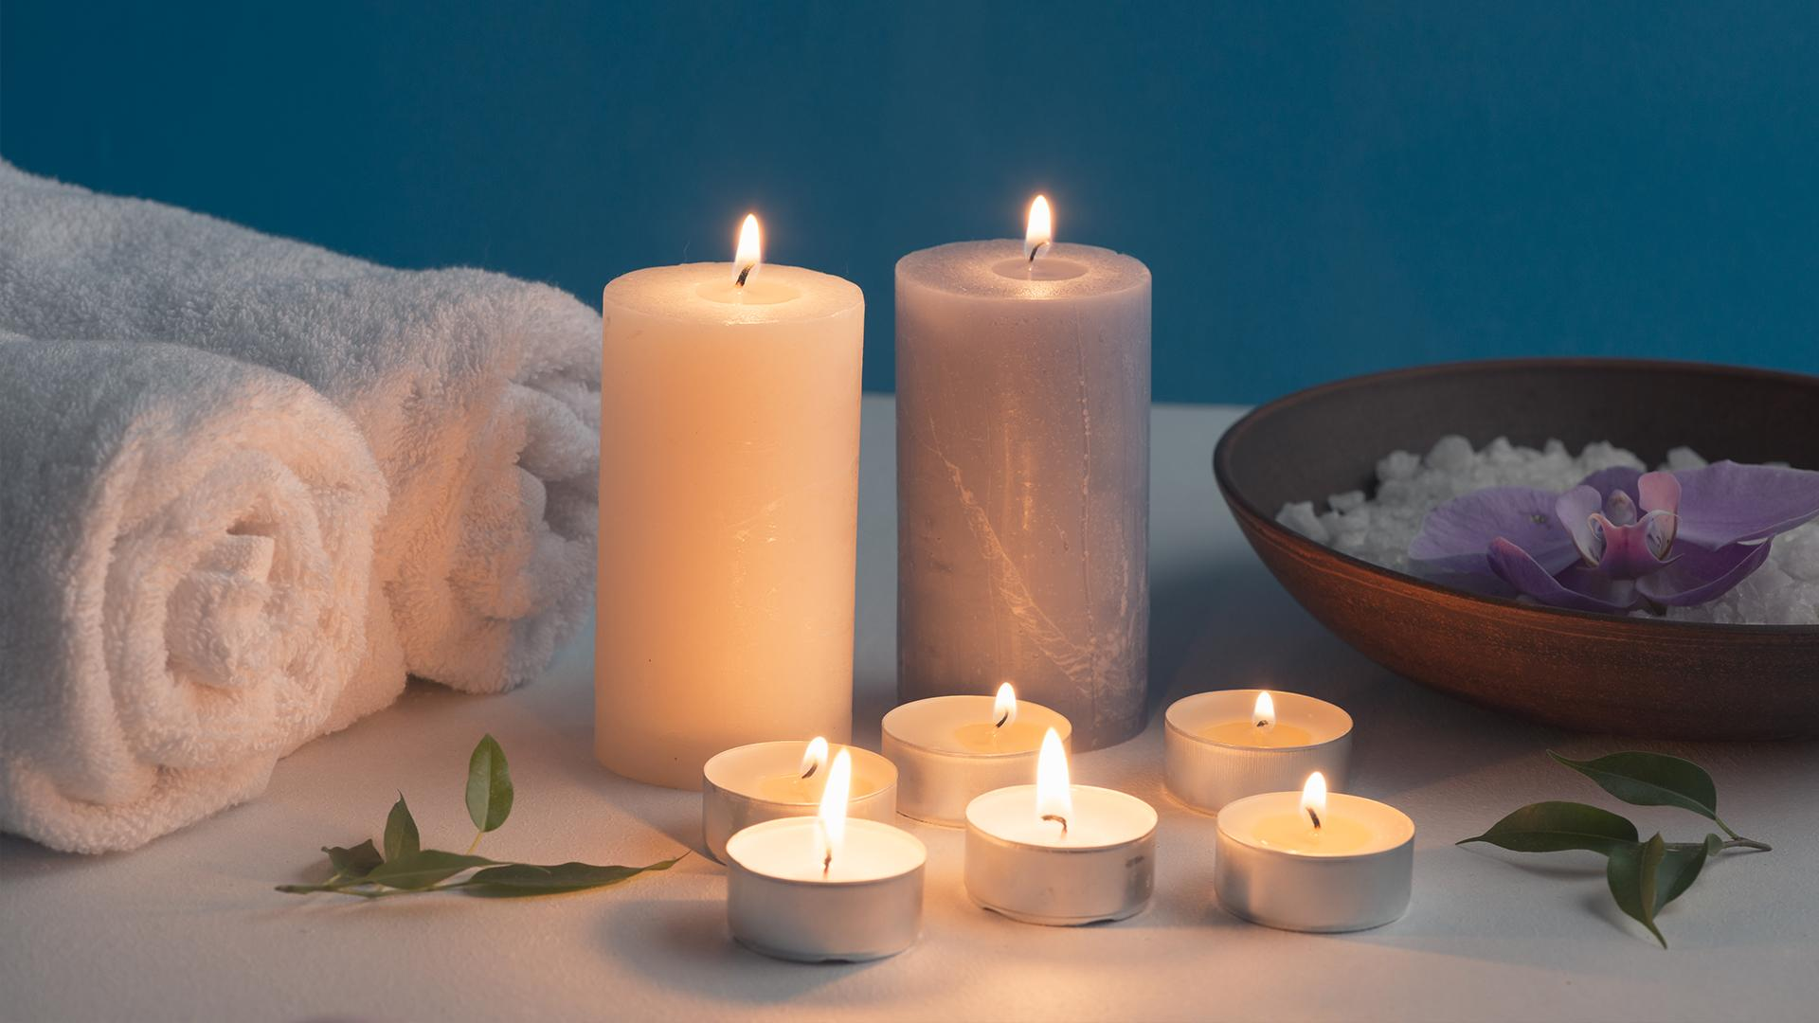
This is a great headline
And this is the subtitle that makes it comprehensible

Slide 11
A timeline always works fine
Day 2
Venus has a beautiful name, but it’s terribly hot
Day 4
Jupiter is the biggest planet in our Solar System
Day 1
Mercury is the closest planet to the Sun
Day 3
Despite being red, Mars is a cold place, not hot

Slide 12
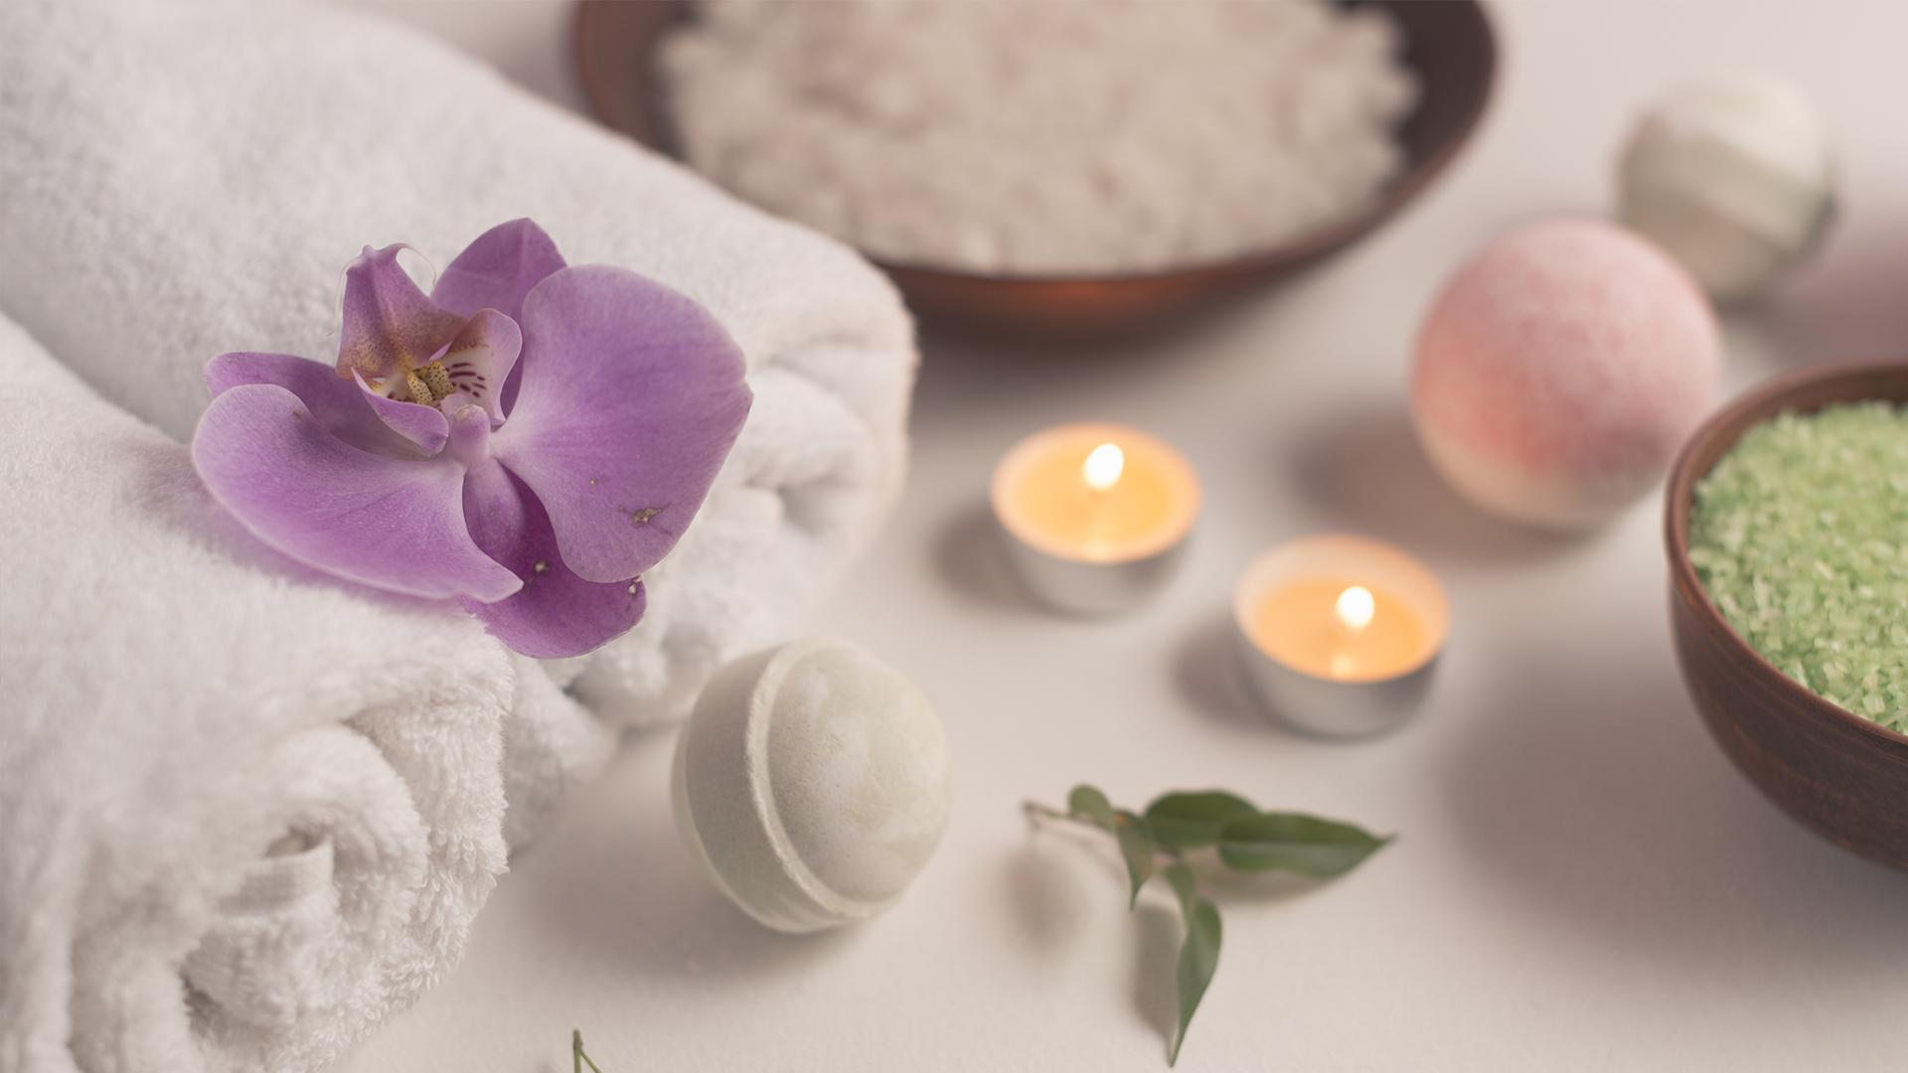
Beautifulwords
Day 1: Mercury is the closest planet to the Sun
Day 2: Venus has a beautiful name, but it’s terribly hot
Day 3: Despite being red, Mars is a cold place
Day 4: Jupiter is the biggest planet in our Solar System

Slide 13
This is a map
more interesting
With some important
to make this presentation
facts you can highlight

Slide 14
333,000.000
23h 57m 15s
386,000km
earths is the Sun’s mass
is Jupiter’s rotation period
is the distance between the Earth and the Moon

Slide 15
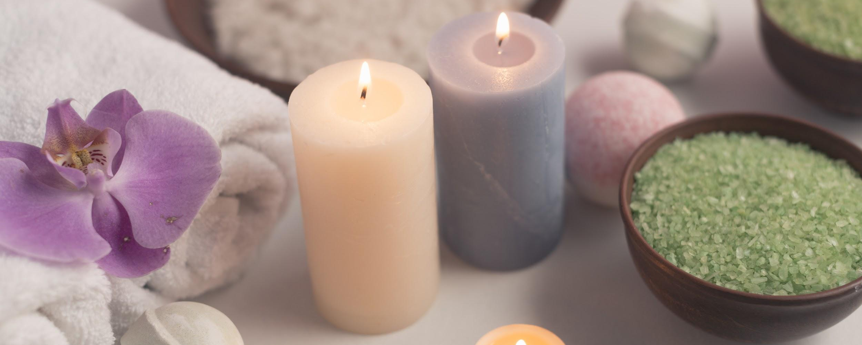
And here comes the slide title!
THIS IS A LIST
It helps you make your point clear
The audience won’t miss the point of your presentation
It gives cohesion to your information
You can organize your ideas

Slide 16
You could use four columns and icons, why not?
Day 1
Mercury is the closest planet to the Sun
Day 2
Venus has a beautiful name, but it’s terribly hot
Day 3
Despite being red, Mars is a cold place
Day 4
Jupiter is the biggest planet in our Solar System

Slide 17
Icons make your idea understandable
Icons reveal large amounts of data quickly, so remember: use an icon instead of long texts. Your audience will appreciate that

Slide 18
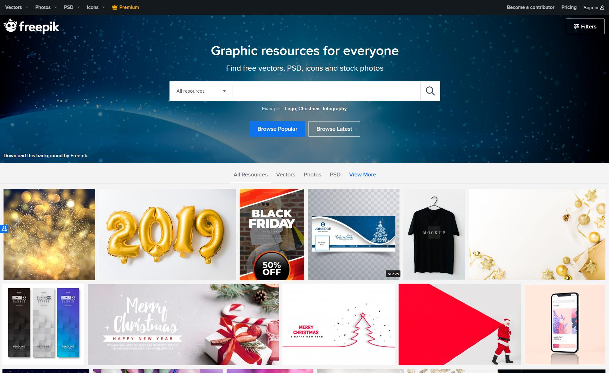
Desktop Software
You can replace the image on the screen with your own work. Just delete this one, add yours and send it to the back

Slide 19
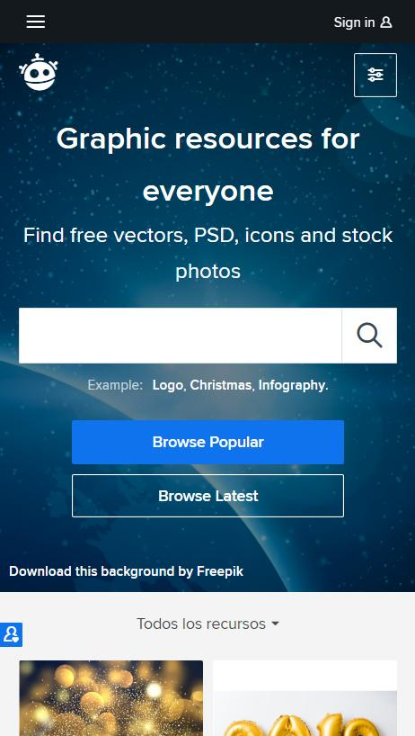
Mobile Web
You can replace the image on the screen with your own work. Just delete this one, add yours and send it to the back

Slide 20
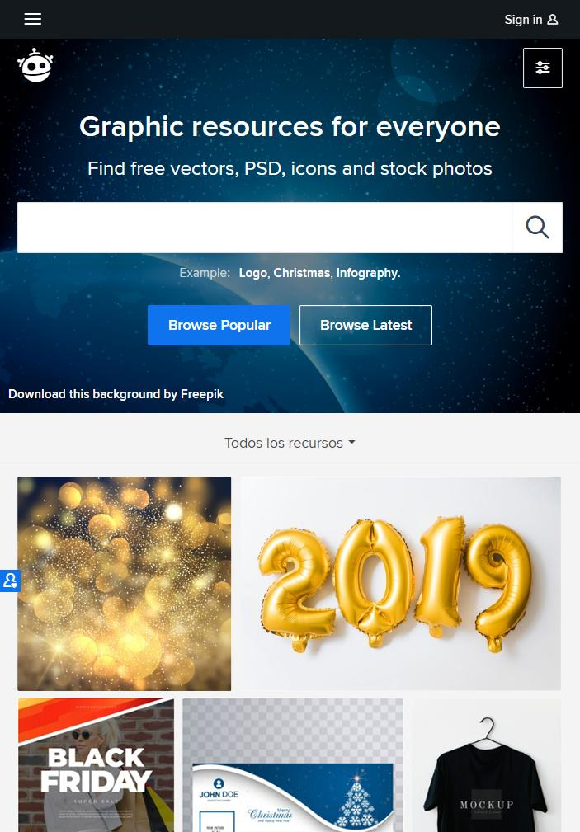
Tablet App
You can replace the image on the screen with your own work. Just delete this one, add yours and send it to the back

Slide 21
Thanks!
Does anyone have any questions?
You can remind people how to contact you:
addyouremail@freepik.com
oradifferentone@flaticon.com

